Slide 1
Welcome to our crossword
-Devendra Saini
-Shubhada Dolas

Slide 2
What is crossword ?
a word game in which you have to write the answers to questions (clues) in square spaces, which are arranged in a pattern

Slide 3
We have created this Game using..
Python language as front end there was no need of backend and we used anaconda Jupiter notebook in this project

Slide 4
Future of the project ?
We are planning to have multiple users high and low score .
Also we are planning to take it online.
We will be using a db, to create a crossword matrix of a user choice in upcoming updates.

Slide 5
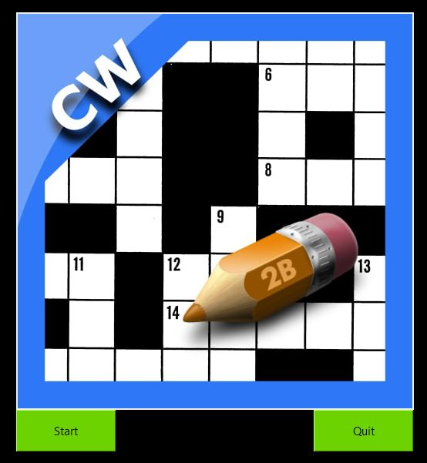
Crossword
This is the welcome screen of our game!
It consist of 2 buttons start and quit.

Slide 6
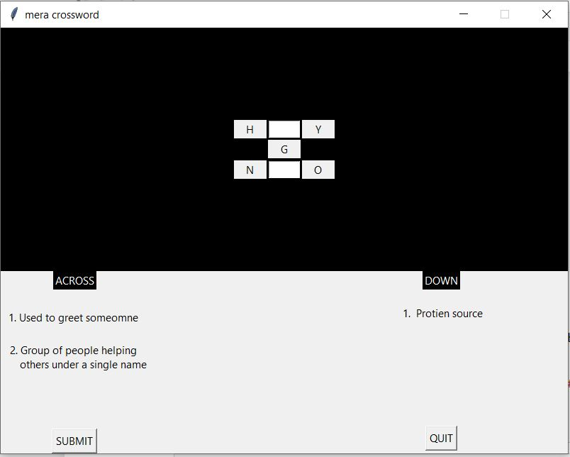
Level 1 page
This is the level 1 screen of our game!
It consist of 2 buttons submit and quit.

Slide 7
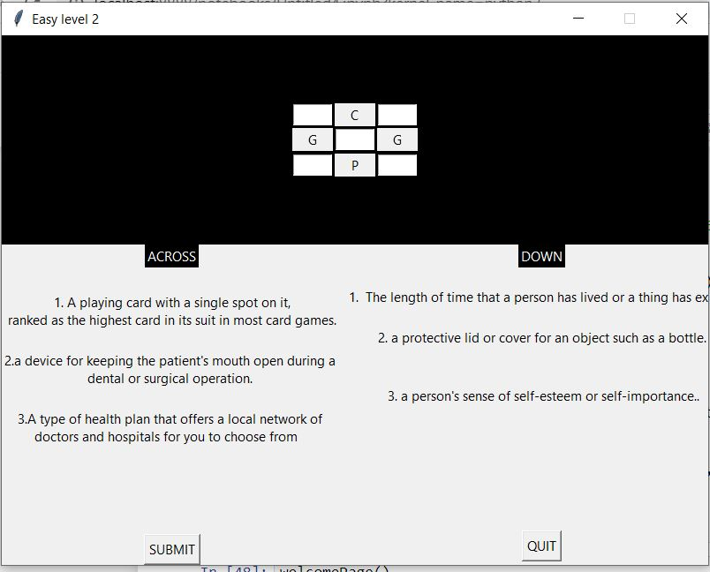
Level 2
This is level 2 screen of our game.

Slide 8
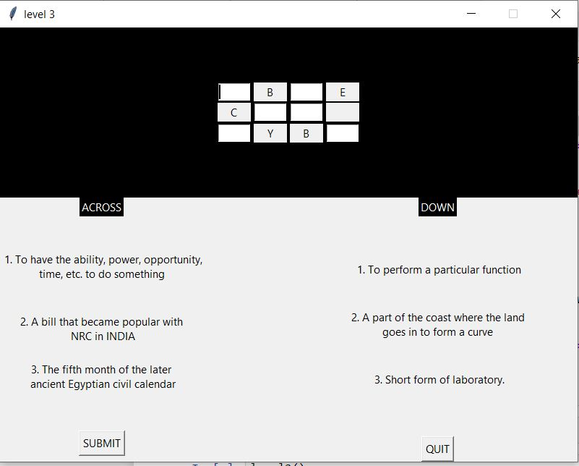
Level 3
This is level 3 screen of our game.

Slide 9
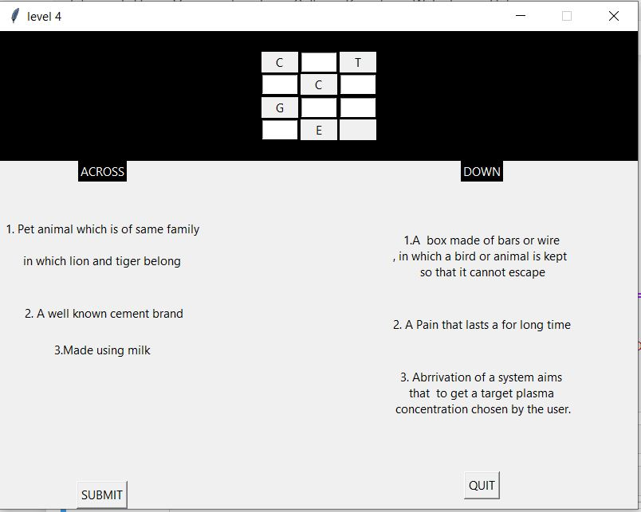
Level 4
This is level 4 screen of our game.

Slide 10
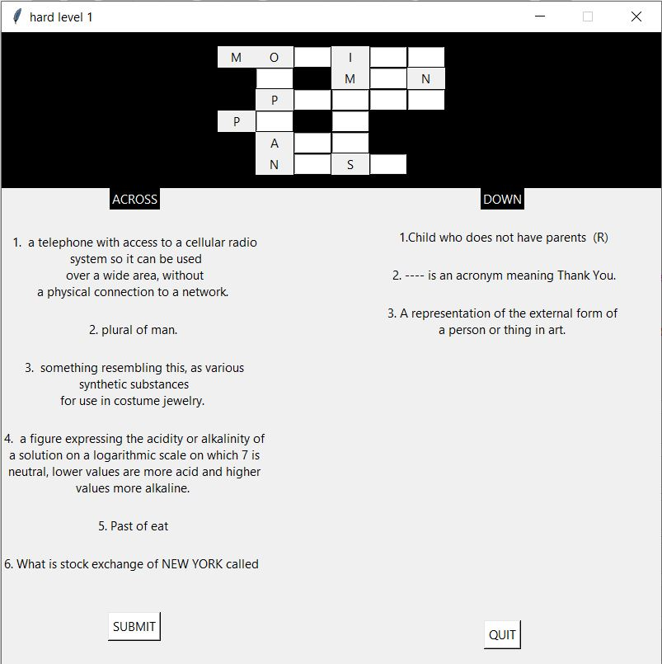
Level 5
This is level 5 screen of our game.

Slide 11
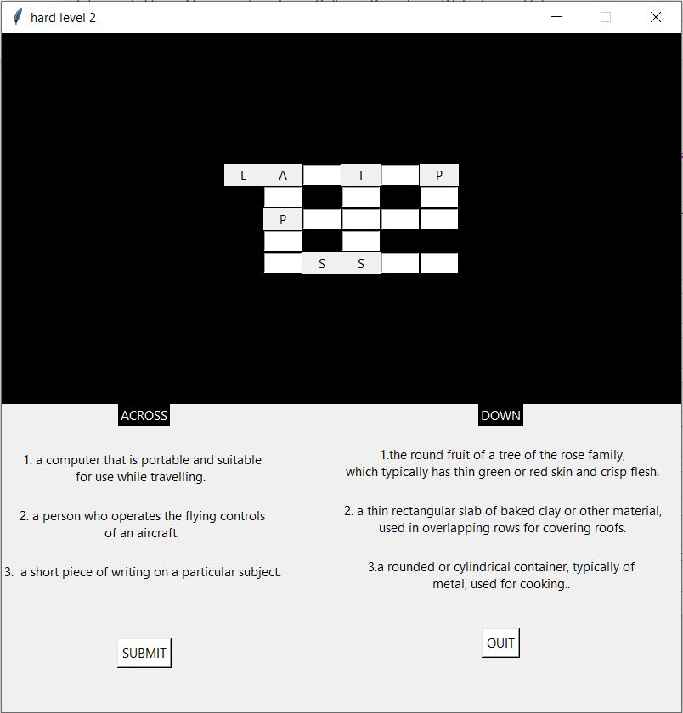
Level 6
This is level 6 screen of our game.

Slide 12
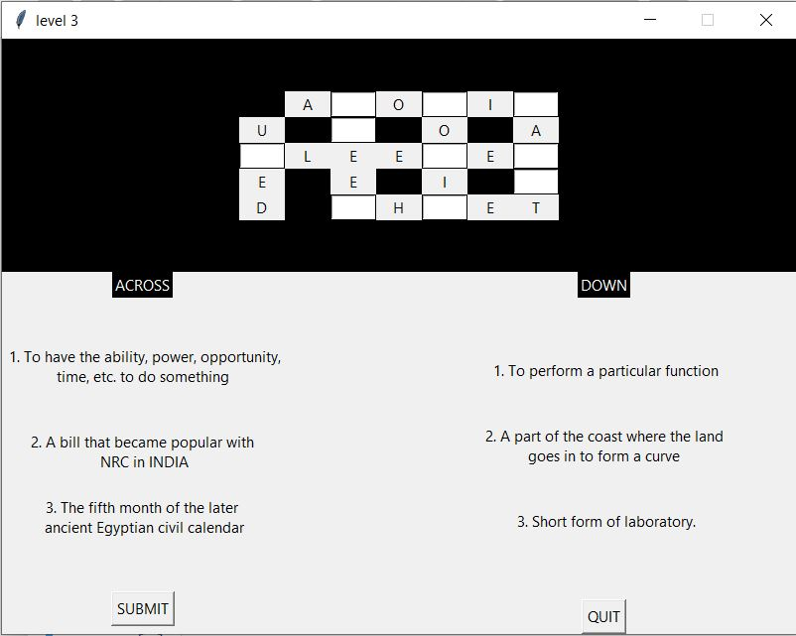
Level 7
This is level 7 screen of our game.

Slide 13
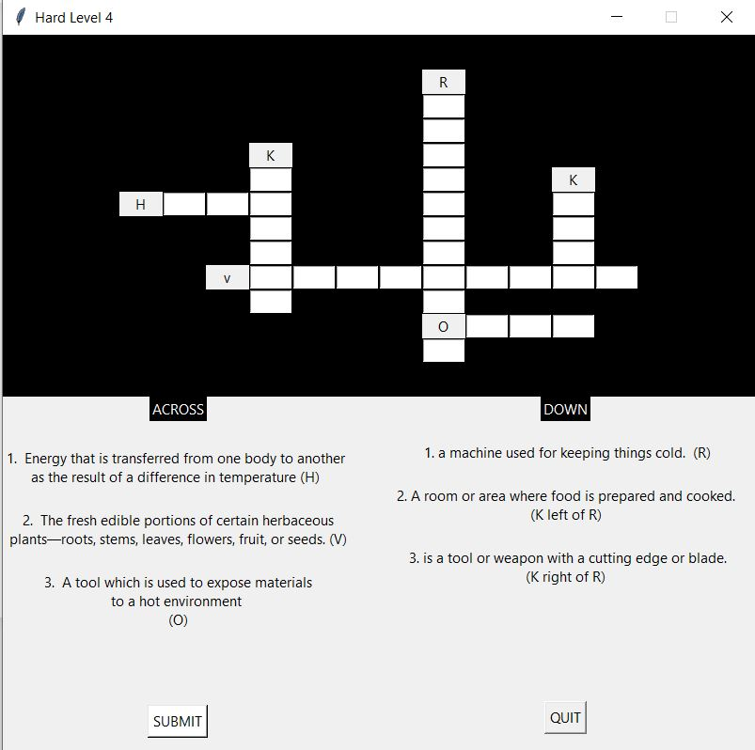
Level 8
This is level 8 screen of our game.

Slide 14
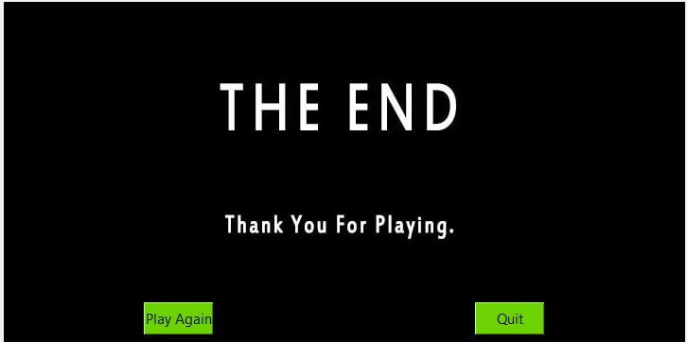
Thank you
This is the last page where we thank our players.

Slide 15
Thank you

